Slide 1
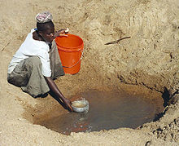
Solar Disinfection of Drinking Water
Safe Drinking Water for Developing Nations and Anywhere in an Emergency

Slide 2
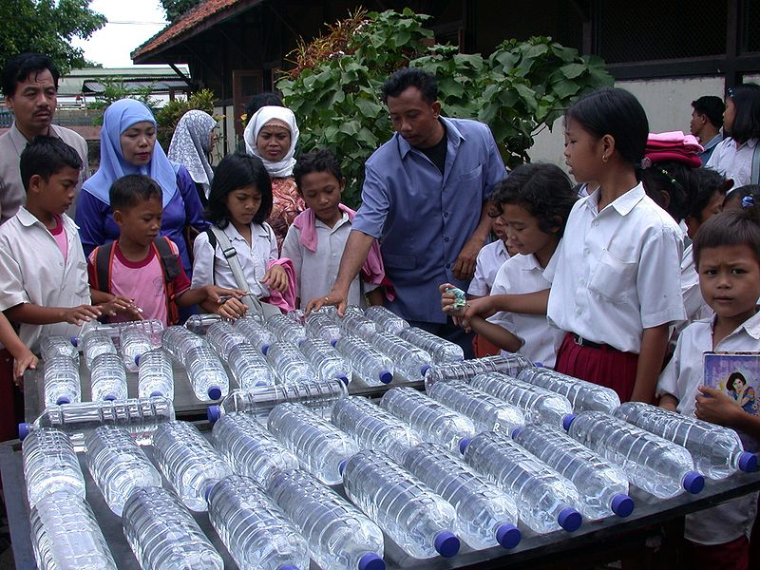
SODIS: SOlar DISinfection
Photo credit: Eawag

Slide 3
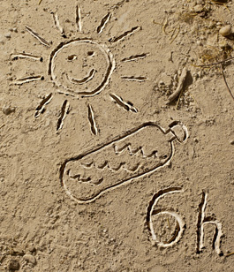
SODIS
Developed by Prof. Aftim Acra at American University of Beirut
Further refined and promoted by Swiss Federal Institute of Aquatic Science & Technology (EAWAG)
See: www.sodis.ch
And numerous others since
Photo credit: sodis.ch

Slide 4
SODIS Methodology
Use clear, colorless PET, <2 Liters
Aerate water by shaking, for best results
Turbidity <30 NTU; otherwise filter first

Slide 5
Mechanisms of Disinfection
UV-A (320-400 nm) interferes with DNA/RNA replication, cell metabolism, structure
Also generates free radicals and peroxides that attack biological materials
IR light heats the water, speeds reactions. At 50 C, disinfection is 3X faster
Hence corrugated metal roof, or black-painted board can be useful.

Slide 6
Health Advantages
Kills most of the most dangerous waterborne pathogens.
Does not eliminate other vectors of disease (e.g., other fecal-oral pathways)
Overall, using communities experience 30-80% reduction in diarrhea

Slide 7
Health Disadvantages?
Toxic plastic leachate?
PET contains NO bisphenyl A (BPA)
Adipates and phthalates: Tests show after 17 h at 60 C, levels far below WHO guidelines, and about same as high-quality tapwater
Antimony (Sb) is released in tiny amounts but far below WHO guidelines

Slide 8
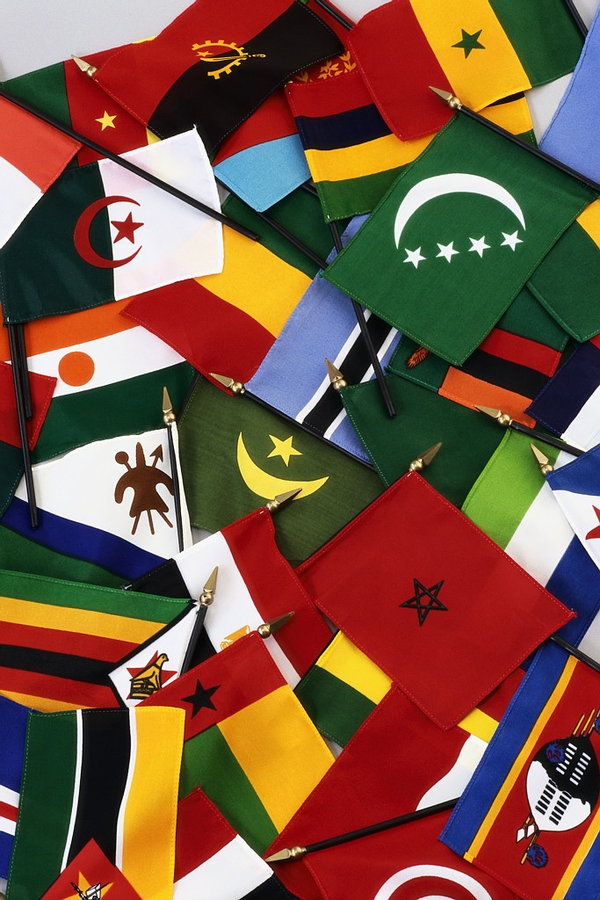
Current Application
33 countries including:
Bhutan, Bolivia, Burkina Faso, Cambodia, Cameroon, DR Congo, Ecuador, El Salvador, Ethiopia, Ghana, Guatemala, Guinea, Honduras, India, Indonesia, Kenya, Laos, Malawi, Mozambique, Nepal, Nicaragua, Pakistan, Perú, Philippines, Senegal, Sierra Leone, Sri Lanka, Togo, Uganda, Uzbekistan, Vietnam, Zambia, and Zimbabwe.

